Slide 1


INDUSTRY
Readiness Programme
For college students of all disciplines
1

Slide 2
Background
Taking a step in the direction of making graduates employable by enhancing their industry readiness, the Confederation of Indian Industry (CII) has launched an ambitious programme which aims at scaling of upskilling interventions in higher education institutions. The programme will make use of technology and also bring industry experts to provide mentoring and guidance to students.
An urgent requirement of educational institutions from industry today is internships for students since the All India Council for Technical Education (AICTE) has made four-six months of internship mandatory for students. With the number of students enrolled in higher education in India being 30 million and with engineering students alone being approximately 0.8 million who take admissions every year, mandatory internship means roughly 4 lakh students in engineering alone needing meaningful engagement with industry on an annual basis. But there are not more than 2.5 lakh registered manufacturing companies in India. Eighty-five per cent of them, as per Asian Development Bank estimates, are very small sized with less than 50 workers. Effective number of decent sized companies which are in the manufacturing sector and which can provide some form of internships, is only about 35,000.
Given this lop-sided scenario and the criticality of ensuring that students find adequate options to hone their skills for corporate world, CII has launched two soft internship programmes called CII Smart Manager Certificate Programme and CII Campus to Corporate Programme. Both programmes make use of technology in a big way and have blended formats. The Campus to Corporate Programme is a six-month programme and includes visits to industry and face to face interactions with industry leaders every month. The Smart Manager Programme on the other hand is a four-month programme in purely digital mode. Both programmes will have CII certification on successful completion by students.
The CII Industry-Readiness Programme will also include a separate assessment of engineers to gauge their level of preparedness for a job in industry and will be called CII IPATE (Industrial Proficiency Aptitide Test for Engineers). This assessment and the way it will be administered across country was also explained at the summit.
While GATE exam is taken by those students who wish to pursue higher studies and take up jobs in public sector companies, CII IPATE is expected to become the benchmark for those who wish to join the private sector corporate world.
2

Slide 3
CII Industry Readiness Programme
Soft Internships
CII Smart Manager Programme
CII Campus to Corporate Programme
Assessment & CII Certification
3

Slide 4

2 components of Industry Readiness Programme
SOFT
internships
4

Slide 5
2 programmes in Soft Internships
CII Smart Manager Certificate Programme
CII Campus to Corporate Certificate Programme
5

Slide 6


Soft Internship
CII Smart Manager Certificate Programme will make students ready for their professional careers with practical competencies that all employers seek. This programme will provide those skills to students that are typically gained through work experience or internships
Mode of delivery
Blended (interactive digital + digital live classroom) through Android, iOS, web apps
Duration
4 Months
6

Slide 7
Soft Internship
CII Smart Manager Certificate Programme
Industry Stalwarts who will be part of this programme
Partners
GlobalGyan
7

Slide 8
Soft Internship
CII Campus to Corporate Certificate Programme will equips graduates and early career talent with the skills they need to ‘hit the ground running’ and be ready for the professional world.
Mode of delivery
Digital + Face-to-Face
Duration
6 Months
8

Slide 9

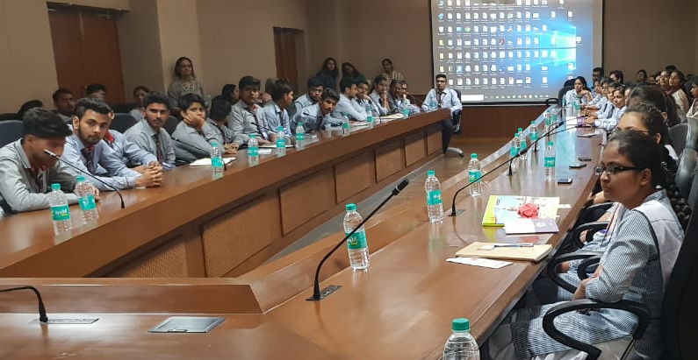
Soft Internship
Internship Structure
Best in Class Experts
Rigorous Program
CII Campus to Corporate Certificate Programme
On-field classroom
Live project for 4 months
Every month industry visits
Partners
Catallyst Constellations
10 Critical
Job-Relevant Skills
Interactive and Engaging Sessions
24 Class sessions
12 Days of GD & PI
10 Industry Expert Sessions
05 Industry tours
03 Refresher Labs
01 Live Project
9

Slide 10
Assessment &
CII Certification
10

Slide 11


CII Industrial Proficiency Aptitude Test for Engineers (IPATE)
The GATE-way to Corporate World
Powered by

Slide 12
Registration
Visit www.ciihighereducation.in to register
Contact neha.gupta@cii.in higher.education@cii.in
Phone: 9818850568

